Slide 1

09
Notes:
Mock-up for recreate Google I/O 2009 - The Myth of the Genius Programmer slides- Only for education purpose

Slide 2
Brian Fitzpatrick & Ben Collins-Sussman
May 2009
The Myth of the
“Genius Programmer”

Slide 3
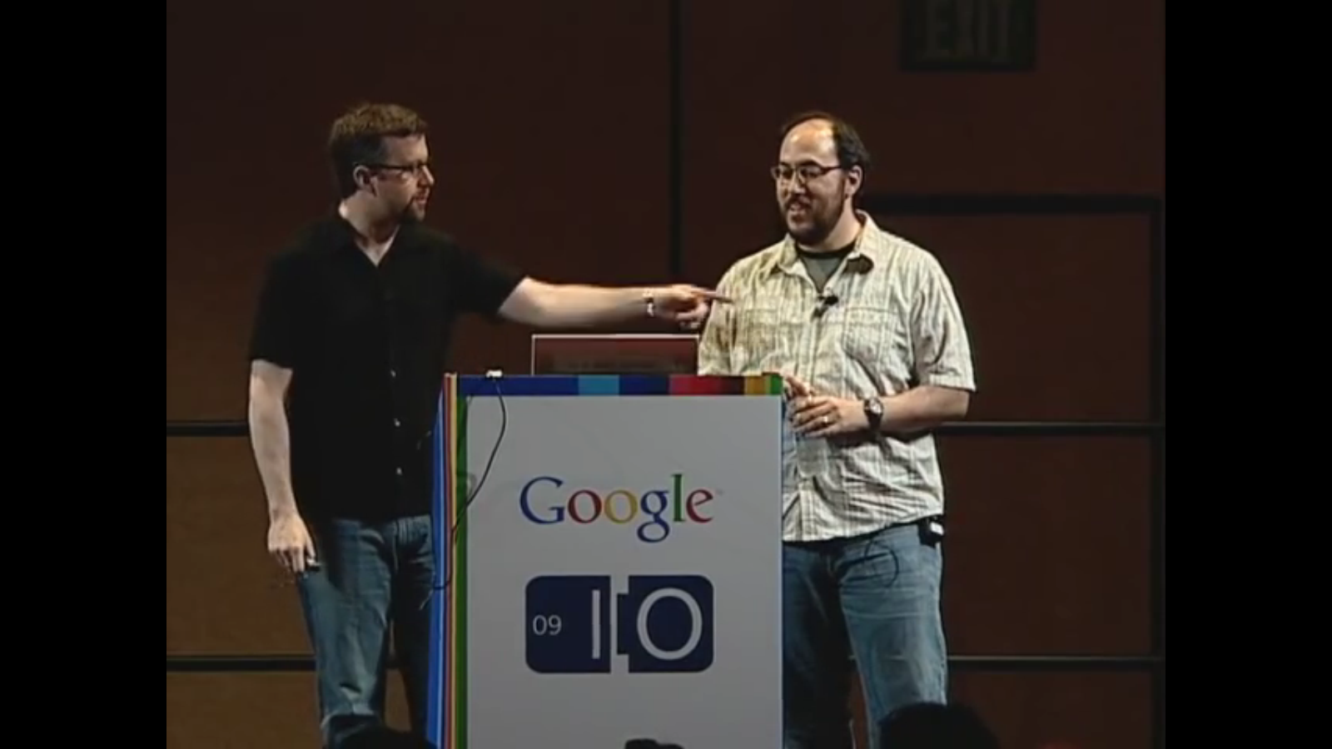

Slide 4
Who are we?

Slide 5
“Can you guys please give Subversion on Google Code the ability to hide specific branches?”
Some Dude at Google I/O, 2008

Slide 6
“Can you guys make it possible to create open source projects that start out hidden to the world, then get ‘revealed’ when they’re ready?”
Some Other Dude at Google I/O, 2008

Slide 7
“Hi, I want to rewrite all my code from scratch, can you please wipe all the history?”
Some Guy on our mailing list

Slide 8
Can you spot the theme?

Slide 9
The Genius Myth

Slide 10
“There’s a pervasive elitism at work in the programming community. Add anonymity to the mix, and everyone is suddenly elite.”
Kyle K (Commenting on Ben’s Blog)

Slide 11
There is no genius.

Slide 12
“You are not a beautiful or unique snowflake.
You’re the same decaying organic matter as everything else.”
Tyler Durden, Fight Club

Slide 13
Avoiding the trap

Slide 14
Lose the Ego

Slide 15
Criticism is not evil

Slide 16
Embrace failure

Slide 17
Practice is key

Slide 18
Be a Small Fish

Slide 19
Be Influenced

Slide 20
Be Vulnerable

Slide 21
“You cannot apply a technological solution to a sociological problem…”
Internet Adage

Slide 22
..but default behaviors matter a lot.

Slide 24
Where sould the third milestone go?

Slide 25
Too early

Slide 26
Sweet Spot!

Slide 27
Case Study: Subversion

Slide 28
Case Study: Ben & Fitz

Slide 29
Obligatory Summary Slide
Don’t try to be a genius
Collaborate early and often
Pay attention to your tools
Pay attetion to timing

Slide 30
But here’s the secret…

Slide 31
…if you do all these things

Slide 32
People Will Think You’re a Genius

Slide 33
09
Notes:
Mock-up for recreate Google I/O 2009 - The Myth of the Genius Programmer slides- Only for education purpose

